Slide 1
Incentives and Financial Supports for Companies Operating in Technopark
Doğan ALANTAR
Charted Certified Accountant

Slide 2
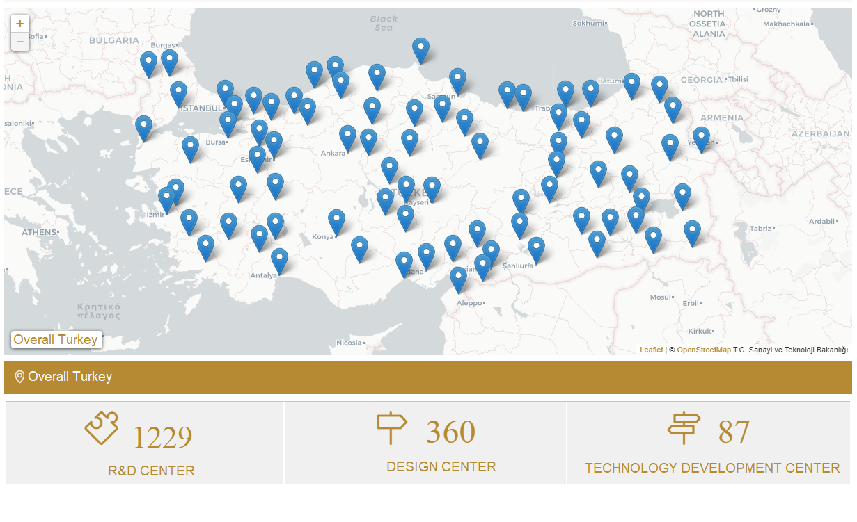
Technopark; Technopark is premises where acedemic, economics and social structure are brought together, it hosts universites, research instutions, indusrial enterprises in same zone and facilities them to do research, development and innovation activites through mutual transfer of technology for creating value-added-products Technoparks in Turkey; Working on establishment of technoparks in Turkey dates back to 1980. As a result, in 1990s, within the collaboration framework of KOSGEB and the Universities, TEKMER ( so-called Technology Centers) were founded.

Slide 3
The purpose of Law of Technopark is to provide firms, where do technologic R&D activities, biringing together under technopark zones in order to cooperate each other and acamedics, and produce value-added products. Firms which have R&D activities in technoparks zones are provided multiple convenience and exemptions related taxations and social security matters.
According to the law, followings can take tecnopark advantages;,
-Managment Company Of Technopark
-Firms operating in Technoparks
-Employees working in Technopark, included acamedics.

Slide 4
Support and Exemption for Firms Operating in Technology Development Zone (TDZ)
Individual and Corporate Tax
Revenues which taxpayers (individual and corporate) getting from software and R&D businesses operating in the Zone, are exempt from individual and corporate tax until 31.12.2028
Salary of R&D Employees and Support Employees are exempt from payroll tax and all other kind of taxes until 31.12.2028.
Number of Support Employee subject to exemption may not exceed 10% of R&D Employees.
Hourly wages for working outside of Technopark Zone under R&D Project, which employees of software development and R&D Employees are entitled, are exempt from payroll tax in accordance with approval of managment company and The Ministry of Industry.
The revenue of management company is exempt from CIT

Slide 5
VAT Exemption
Softwares produced by enterprises subject to Corporate Income Tax Exemption in the zone for system managment, data management, business practice, sectorel, internet, mobile and military control practice, are exempt from Value-Added Tax until 31.12.2028

Slide 6
Property Tax Exemption
Managment Company is exempt from property tax for premises it owns located inside of the Zone
Providing that ownership of lands are held by University, Land of Universities inside of the Zone can be granted to the managment company, in case University approves. This can be applicable for the lands of public organizations as well.

Slide 7
Social Security Premium Support
Pursuant to Article 3 of the Law No. 5746 on Supporting Research and Development Activities, regarding personnel working in companies operating in Technology Development Zones and whose wages are exempt from income tax pursuant to the Law No. 4691; half of the employer's share of the insurance premium calculated over their wages in return for this work is covered from the allowance to be added to the budget of the Ministry of Finance.

Slide 8
Custom Tax Exemption
Goods which are imported for the purpose of using on software works, R&D, innovation and design business are exempt from custom tax and all kind of papers under this scope are not subject to stamp tax.

Slide 9
Supports Provided to Academics
Personnel from public institutions and organizations and universities, whose services are needed as researchers and administrative staff in the activities in the Zone, can be employed on a permanent or part-time basis with the permission of the institutions they work for
For the faculty members, lecturers, research assistants and experts who work part-time, their income in return for these services are excluded from the scope of the university revolving fund.
Personnel who will be permanently employed are given unpaid leave by their institutions and their relations with their personnel cadre continue.
Instructors can carry out their studies in accordance with the principles of temporary assignment in the country and abroad stipulated in Article 39 of the Law No. 2547 in institutions in the Zone with the permission of the University Administrative Board. The incomes of faculty members assigned in the Zone on a paid leave are excluded from the scope of the university revolving fund.
Faculty members may establish companies, become a partner in an established company and/or take part in the management of these companies in these zones, with the permission of the University Administrative Board, in order to commercialize the results of their research.

Slide 10
Out of Zone Work Permit
In cases where it is necessary to carry out some of the activities within the scope of the project outside the Zone, provided that they are directly related to the projects carried out, fees of R&D and design personnel working in the enterprises in the Zone, provided that the fees for these activities outside the Zone do not exceed one hundred percent, the portion to be determined separately or jointly by the President is evaluated within the scope of income tax withholding incentive.

Slide 11
Support for Technologic Product
Businesses can make the necessary investment within the Zone for the production of the technological product they have obtained as a result of the R&D projects they initiated and concluded in the Zone, provided that the management company approves and the Ministry gives permission. The personnel working in the Zone due to these investments and the earnings to be obtained from these investments are taxed according to the principles to which the enterprises and their personnel out of the Zone are subject.

Slide 12
Ease of Employing Foreign Personnel and Encouragement of Foreign Investors
➔ Within the framework of Law No. 4875, Law No. 4817 of 27/2/2003 on Work Permits of Foreigners and relevant legislation, foreign national managers, qualified R&D or design personnel can be employed in the Zones.
➔ Foreign private legal entities may participate in the managing company within the framework of the Foreign Direct Investment Law No. 4875 dated 5/6/2003 and the relevant legislation. Also, foreign investors can carry out their R&D, Software and Design activities within the Zone, within the scope of the laws numbered 4691, 6170 and 6676.

Slide 13
Special Supports Provided to TÜBİTAK Projects
If a project supported by TÜBİTAK is located in the Technology Development Zone, donation provided for personnel expenditures within the scope of R&D activities can be increased up to 90%.

